Slide 1
Create Multi-Platform Apps
with .NET MAUI & the MAUI Community Toolkit
Alvin Ashcraft
Sr. Content Developer, Microsoft
Notes:
Welcome, folks! I hope you’re having a great week at CodeMash! Welcome to the first day of regular sessions. In this session, we’ll be looking at .NET MAUI and the Community Toolkits.

Slide 2
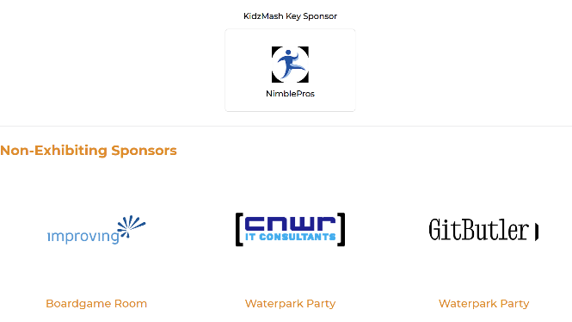
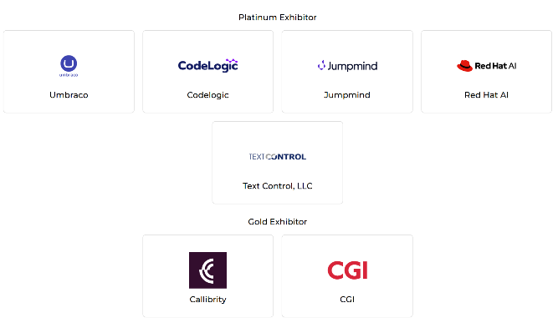
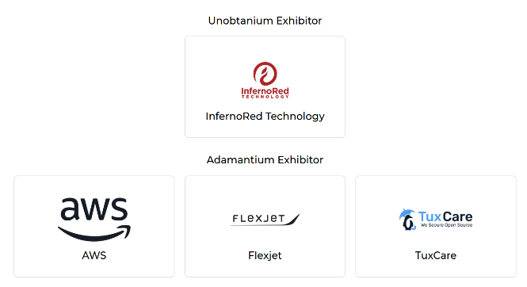

Thank You Codemash Sponsors!
Notes:
First don’t forget to visit the CodeMash sponsors this week and thank them for making this event possible.

Slide 3

Agenda
About Me
Introduction to .NET MAUI and Cross-Platform Apps
Develop on Windows and macOS
Rapid App Building with XAML, C# & Visual Studio
Enhance Apps with the .NET MAUI Community Toolkit
Simplify Your MVVM Architecture with the MVVM Toolkit
Build Apps with C# Markup in VS Code: No XAML Required
Style Apps with CSS
Access Platform-Specific Features
Foundry Local models on Windows & Android (time permitting)
Q&A
Notes:
We will cover an introduction to .NET MAUI, development tools, rapid app building techniques, enhancing apps with the MAUI Community Toolkit, architectural patterns like MVVM, styling options, platform-specific features, and conclude with a Q&A session.

Slide 4
About Me
Software industry for 30+ years
Started programming in 1995 (VB 3 & Microsoft Access)
Content developer at Microsoft since 2022
Morning Dew link blog
Daily links for .NET developers since 2007
Three books for Packt Publishing
Learn WinUI 3 (two editions)
Parallel Programming and Concurrency with C# and .NET
TechBash dev conference organizer since 2016
Notes:
A little background about me…
For those who don’t know me, I’ve been in the software industry since 1995, with most of that time (over 25) years spent as a developer and architect using various Microsoft technologies.
Some of you may also be familiar with my blog, the Morning Dew, where I’ve been posting daily links for .NET developers since 2007.
I also have three books from Packt Publishing. You can check those out on Packt’s website or on Amazon. Just search for my name.
Writing those books led me to pivot my career to technical writing. I joined Microsoft almost four years ago as a content developer. I write documentation, training modules, and code samples on Microsoft Learn. I work on the Microsoft Foundry docs team, helping to maintain the docs for Foundry’s agent tools.
Finally, I’m one of the founding organizers of the TechBash developer conference. We’ve been running the event in the Poconos since 2016.

Slide 5



October 13-16, 2026 | Pocono Manor, PA
Great speakers with top content
A fraction of the cost of the more crowded conferences
- 3-day conference plus lodging for ~$1000
Full-day deep dive preconference sessions available
Easy travel from almost anywhere
World-class keynotes
In addition to the sessions, you get a great hallway
Track, amazing food, attendee Welcome Reception, Game Night & more
Family Day Friday - full day of kids' sessions, free for attendees' families
Discounted Kalahari Resort rooms with water park access: stay, learn & play all week
https://techbash.com or @techbash
Notes:
TechBash 2026, our 9th event, will be happening this fall at the Kalahari Resort in the Poconos.
Our content is similar to CodeMash, but we have one day of workshops, three days of sessions, and Family Day with kids’ sessions on Friday.
Check us out at techbash.com and look for our Call for Speakers next month.

Slide 6
Overview of .NET MAUI & Supported Platforms
Multi-platform Framework
.NET MAUI allows building apps for multiple platforms using a single shared codebase.
Supported Platforms
.NET MAUI supports Windows & macOS on the desktop and the iOS & Android mobile operating systems enabling cross-device compatibility for most app users today.
Notes:
Before diving into the intro material, how many of you are at least somewhat familiar with MAUI? Maybe you’ve created and run a basic Hello World app?
.NET MAUI stands for Multi‑platform App UI. It’s the evolution of Xamarin.Forms with a modern project structure and better performance. It was created for .NET developers who want to ship on desktop and mobile from a shared codebase.
A single codebase reduces maintenance and accelerates development. You write once and deploy to multiple platforms, while still delivering a native look and feel. Later in the talk we’ll show how tooling and the Community Toolkits make this even faster.

Slide 7
Benefits of a Single Codebase
Reduced maintenance
A single codebase simplifies updates and bug fixes, lowering the time and resources needed for maintenance.
Faster development
Developers can build and deploy features faster by writing code once for all platforms.
Consistent user experience
Using a unified codebase ensures users enjoy the same experience across devices and operating systems while still providing native performance and look & feel.
Notes:
Let’s talk about why a single codebase matters. With .NET MAUI, you write once and deliver to Windows, macOS, iOS, and Android—all from the same project.
Reduced maintenance means fewer projects, fewer duplicated fixes. One change in shared code propagates across platforms, which lowers our bug surface and speeds up updates.
Faster development: Reuse UI, services, and business logic. With a single project and shared resources, you spend more time building features and less time wiring platform-specific plumbing.
Consistent user experience: A unified codebase makes it easier to keep behavior and design consistent across devices, while still using native controls under the hood for platform fidelity.
MAUI’s single-project model and cross-platform APIs simplify targeting multiple OSes, and you can still access platform-specific features when needed.
Think about a shared settings page or an app theme—implement it once, and it runs on desktop and mobile with native look & feel.

Slide 8
MAUI vs. Other X-Plat Frameworks
Language
Ideal choice for .NET developers. Frameworks like Flutter and React Native require other technical expertise.
Enhanced Performance
Enables faster and more efficient app execution compared to PWAs or React Native.
Community and Ecosystem
Puts Microsoft in your corner. 3rd party libraries & controls are available but not required for building rich, performant apps. The .NET MAUI Community Toolkit and .NET Community Toolkit offer additional libraries supported by the open-source community.
Notes:
Let’s talk about .NET MAUI vs. other cross‑platform options. The core idea is with MAUI you get a single .NET codebase that targets Windows, macOS, iOS, and Android, while still delivering native UI and performance on each platform. .NET is the key advantage. If you’re already a C# developer, you have a leg up when choosing MAUI.
MAUI is the evolution of Xamarin.Forms, rebuilt for performance and a single‑project model. On Windows it uses WinUI 3 and the Windows App SDK, so your MAUI app on Windows feels like a native WinUI app while sharing most code across platforms.
You can write UI in XAML or C# and access platform APIs via a unified .NET surface; when you need it, you can add platform‑specific code. That balance keeps the ‘write once, run anywhere’ workflow practical.
React Native (and React Native for Windows) — JavaScript/TypeScript with a bridge to native controls; strong for teams already invested in React. MAUI’s advantage is C#/.NET end‑to‑end and first‑class WinUI support on Windows.
Flutter — Dart + Skia rendering gives consistent UI across platforms, but it’s not using native platform elements on Windows; MAUI uses the native UI on each platform, which can improve platform‑specific behavior and accessibility.
Blazor Hybrid — Great when you want to reuse web UI with .NET; it’s a strong fit if your team is already Blazor‑centric. MAUI remains the go‑to for native UI scenarios with XAML/C# while still allowing Blazor where it makes sense.
PWAs — Fast to ship and easy to update, but they’re web‑first and don’t provide native controls or the same access to device features as MAUI.
Next, we’ll look at the tooling that makes this practical.

Slide 9
IDEs and Tools
Primary IDEs
Visual Studio on Windows and VS Code on Windows and macOS serve as the main development environments for .NET MAUI development.
Supporting Tools
VS Code, GitHub Copilot, and CLI tools complement the primary IDEs by supporting flexible and lightweight development workflows. .NET MAUI Community Toolkit offers open-source controls and helpers for your apps.
Additional Options
JetBrains Rider supports .NET MAUI development on Windows and macOS.
Notes:
Now, the tools you’ll use to build .NET MAUI apps. The two primary IDEs are Visual Studio (Windows) and VS Code (Windows and macOS), with JetBrains Rider as an alternative for Mac and Windows users who prefer it. All of them support the .NET MAUI workflows we’ll cover.
Visual Studio is the most fully featured option for MAUI with built‑in project templates, device emulators, the Hot Reload experience for both XAML and C# code, and the Live Visual Tree and Binding Failures windows for rapid UI debugging.
VS Code is a lighter, cross‑platform editor that can still be very productive for MAUI with the right extensions—project scaffolding, build/publish helpers, and the MAUI Archive & Publish extension for packaging iOS/Android from VS Code.
It’s great for quick iterations, C# Markup work, and people who prefer a lean editor while keeping the same .NET toolchain.
Rider is a solid alternative if you’re already in the JetBrains ecosystem; it supports .NET MAUI projects with the usual Rider tooling, debugging, and refactorings. It’s a good choice when your team standardizes on Rider or you need a richer dev experience on macOS.
The .NET CLI powers builds, workloads, and templates.

Slide 10
Debug & Build Across Platforms
Debugging Tools Usage
Use debugging tools like XAML Hot Reload, Live Visual Tree, and Visual Studio’s Binding Failures window to identify and fix issues effectively during development across platforms.
Simulators and Emulators
Simulators and emulators for Android and iOS replicate different platforms, enabling real-time testing without physical devices. Connect to a Mac from Visual Studio on Windows to debug iOS apps from your favorite IDE.
Notes:
Let’s highlight the tooling that makes cross‑platform development fast and reliable in .NET MAUI. These are the core features I use every day: Hot Reload, the Live Visual Tree, the Binding Failures window, and testing across device emulators and real hardware.
With XAML Hot Reload you can change XAML while the app is running and see updates instantly—no stop/start cycle. It works for .NET MAUI (and other platforms like WPF and WinUI). It’s a big time‑saver when tuning layouts and styles. Tip: If you’re doing performance profiling, consider turning Hot Reload off, because it adds diagnostic overhead that can affect CPU/memory readings.
Use the Live Visual Tree to inspect the runtime UI hierarchy and quickly locate elements. If a binding isn’t working, the XAML Binding Failures window shows failures in a searchable, sortable list. This is far better than digging through the Output window, which is what we used to do to find failures. It’s especially helpful when your view model properties or DataContext change.
Run and debug apps on Android emulators and iOS simulators to catch platform‑specific layout or behavior issues early. For macOS/iOS debugging from Windows, you can connect to a Mac. You still get the full debugger experience.
When you need to validate sensors, camera, or file access, run on a provisioned device. This helps confirm permissions and platform quirks that emulators sometimes mask.
Together, these tools reduce iteration time and surface issues early—so you can keep the single codebase advantage without the risk platform quirks. In short: edit fast, inspect deeply, and test everywhere.

Slide 11
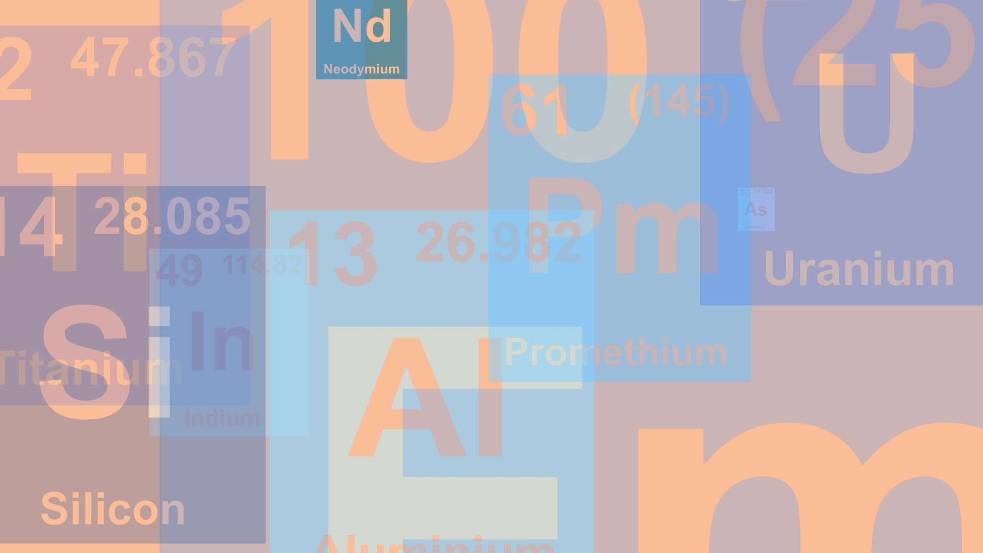
Productivity Tips
Hot Reload Feature
XAML Hot Reload & .NET Hot Reload enable instant code and markup changes, speeding up development & reducing testing time.
Use of Templates
Templates provide reusable structures, enhancing consistency & saving time coding.
Extensions for Quality
Visual Studio & VS Code extensions add functionality & help maintain high code quality across platforms.
Notes:
This slide is all about small habits and tools that add up to big productivity gains when you build .NET MAUI apps. I’ll call out a few quick wins you can use right away.
Use XAML Hot Reload and .NET Hot Reload to iterate without restarting the app. Change XAML or C# code, and the running app updates in seconds—huge time‑saver for UI tweaks and layout fixes.
Start with the built‑in .NET MAUI project templates to get the right structure, SDK refs, and platform targets. They reduce setup friction and keep projects consistent.
On VS Code, the MAUI Archive & Publish extension speeds packaging and publishing workflows—especially handy if you like a lighter editor or CI scripts.
In Visual Studio, use the built‑in publish tooling for Windows (MSIX) and platform‑specific publishing; it keeps your release path clear. You can also leverage GitHub Copilot VS or VS Code to generate unit tests for the code in your MAUI projects.

Slide 12
Build UIs with XAML or C#
XAML markup for clear & declarative UI design when building responsive UIs.
Code behind in C#
Separation of concerns with MVVM
Create UI in code with C# Markup
MVU pattern for robust apps
No XAML learning curve
Demo: .NET MAUI projects in Visual Studio 2026
Notes:
Here we’re looking at two ways to define UI in .NET MAUI: XAML and C# Markup.
Why choose XAML?
Declarative, familiar, and tool‑friendly: XAML is an XML‑based markup that cleanly separates UI from code‑behind and works seamlessly with data binding, styles, and behaviors. It’s the default for many .NET developers and has strong editor support in Visual Studio and VS Code.
Great for design‑centric or complex pages: When you want clear, readable layout definitions, resource dictionaries, and platform‑specific values, XAML is a solid choice.
Hot Reload friendly: XAML Hot Reload speeds iteration by applying changes while the app runs.
Why choose C# Markup?
Programmatic UI with fluent APIs: The .NET MAUI Community Toolkit’s C# Markup provides fluent helpers to build UI in code. This is useful when UI is highly dynamic or generated from data.
Single‑language flow: If your team prefers staying in C# across pages and view models, C# Markup keeps everything in one language and works with .NET Hot Reload.
Easy to compose and reuse: Fluent extensions make it straightforward to define layouts, bindings, and converters inline, which can reduce boilerplate for certain patterns.
Some best practices…
Keep view models and logic out of the UI layer; use binding and commands in both XAML and C# Markup.
Use ResourceDictionaries for shared styles and themes (works for both XAML and code).
Leverage the Community Toolkit for converters, behaviors, and the Markup helpers to reduce boilerplate.
Let’s look at a couple of demos to see what you get out of the box with MAUI templates in Visual Studio. (Not C# markup yet.)

Slide 13
Toolkit Overview
Reusable UI Components
Microsoft’s Community Toolkits provide reusable components that speed up UI development and maintain consistency.
Functionality Enhancements
Extensions, converters & animations add new features that extend the capabilities of existing UI elements.
Improved Responsiveness
Behaviors improve app responsiveness by managing user interactions smoothly.
Demo
Toolkit docs on Microsoft Learn
MAUI projects with Toolkit features
Notes:
<<<Time check – 8:55am>>>
The .NET MAUI Community Toolkit is a collection of reusable building blocks—controls, behaviors, converters, and helpers—that speed up common tasks in MAUI apps and reduce boilerplate. It’s community‑driven and open source, with Microsoft engineers and contributors maintaining the docs and samples.
What’s in the Toolkit?
It’s organized into logical areas: Animations, Behaviors, Converters, Extensions, Image Sources, Layouts, Views, and C# Markup helpers. You’ll also find essentials like popups, drawing, and clipboard helpers. These are ready‑to‑use and plug into your MAUI app with a NuGet package reference.
The docs list each feature with usage examples and API references—handy when you’re deciding whether to build a small helper yourself or reuse a vetted component.
The Toolkit frees you from reinventing common UI patterns, improves consistency across screens, and keeps your app codebase lean—especially useful when you’re targeting Windows, macOS, iOS, and Android from the same project.
Let’s dive back into demos. We’ll look at the Community Toolkit on GitHub and the docs for it on Learn. Then we’ll look at the sample app and a little sample that I created. You’ll see how easy it is to integrate.
Next, we’ll look at the MVVM Toolkit, part of the .NET Community Toolkit.

Slide 14
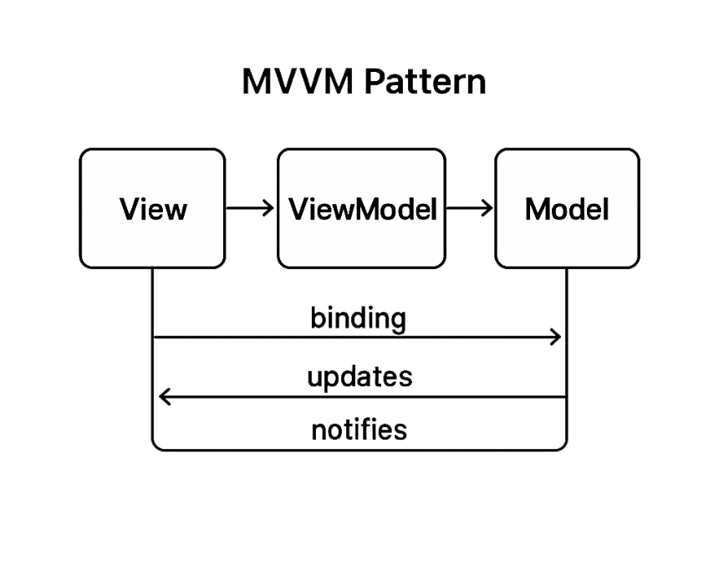
MVVM in MAUI Apps
Separation of Concerns
MVVM separates UI from business logic for cleaner & modular code design.
Improved Code Organization
Using MVVM enhances code maintainability and organization in .NET MAUI applications.
Easier Testing
MVVM facilitates unit testing by isolating business logic from UI elements.
Notes:
Model-View-ViewModel or MVVM.
You may have used it in other XAML-based frameworks like WinUI or WPF. You can even leverage it in modern WinForms apps. How many people are already familiar with the pattern?
The core of MVVM is the separation of UI elements in the view from the presentation logic in the view models, and the data and business logic in the model.
The separation of concerns makes it possible to unit test the logic in your view model and model layers without any dependencies on the UI.
Model types are exposed and bound through the view model to the view. Property change and collection change notifications notify the view when it needs to refresh to display new or changed data. Actions are triggered in the view model through commands rather than event handlers.
Next, let’s see how the MVVM Toolkit simplifies MVVM for developers.

Slide 15
Reduce Boilerplate with MVVM Toolkit
Minimizing Repetitive Code
Base classes designed to reduce repetitive coding tasks efficiently.
Streamlining Development
Helpers in the toolkit streamline the development process, enhancing productivity & maintainability.
Notes:
With traditional MVVM approaches, you either implement the INotifyPropertyChanged interface in each of your view models or more likely in a shared base class.
The MVVM Toolkit provides this base class for you. Not only that, but there are also helpers and source generators that allow you to decorate your private fields and methods with attributes, so you never have to write the corresponding public properties and commands that are bound in the view. They’re generated for you in a partial class. We’ll see how this works shortly.

Slide 16
Build Scalable Apps
Data Binding
Use data binding to synchronize UI and data models efficiently, enhancing app responsiveness and maintainability.
Command Patterns
Apply command patterns to encapsulate requests as objects, facilitating flexible and reusable code.
Dependency Injection
Use dependency injection to manage component dependencies, promoting modular and testable code architecture.
Messaging
Keep Views and View Models loosely coupled with pub/sub messaging.
Demo – Use the MVVM Toolkit in Your Project
Notes:
Let’s talk about the core concepts we use to scale .NET MAUI apps: data binding, commands, and dependency injection. Together, they keep UI, logic, and services loosely coupled so the app stays manageable as it grows.
Data binding connects UI properties to view‑model properties, so the UI updates automatically when data changes, without manual UI code. In XAML, you set the BindingContext and use binding expressions; in code, you call SetBinding. Compiled bindings (x:Bind) add type safety and performance.
This reduces boilerplate and keeps your views declarative, which is key for maintainability as screens multiply.
Commands move action logic out of event handlers in the code‑behind into the view model methods. Controls bind to ICommand, so button clicks, menu actions, and gestures invoke view‑model logic consistently across platforms.
That makes behaviors easier to test and reuse, and it keeps UI layers thin—exactly what you want as your app grows.
Use the Microsoft Dependency Injection container to register services, view models, and pages. DI removes the need for classes to locate their dependencies and manages lifetimes, which improves testability and maintainability. In a MAUI app, you typically register your services and view models in MauiProgram.CreateMauiApp with ConfigureServices, then inject them into constructors.
Together, these patterns let teams add features without tight coupling: views stay simple, presentation logic lives in view models, and services and models are faked or mocked easily for testing.
Let’s look at a demo app and how it uses the MVVM Toolkit.
Next, we’ll look at building MAUI apps without XAML.

Slide 17
C# Markup
Programmatic UI Creation
Create and modify user interface elements using C# markup programmatically.
Improved Code Reuse
Enhance code reuse by allowing modular UI components to be managed efficiently.
Reduced Context Switching
Using C# markup reduces context switching between design and code environments for developers.
Notes:
C# Markup is part of the MAUI Community Toolkit.
If you or your team aren’t comfortable working with XAML, you can leverage C# Markup to declaratively build your UI entirely in C# with fluent helpers.

Slide 18
Recommended Scenarios
Dynamic Layouts
Get flexible, dynamic layouts that adjust automatically based on data and user interactions.
Data-Driven UI Generation
UI elements can be generated dynamically from data sources, improving responsiveness and customization.
Demo – Create a Project w/ C# Markup
Notes:
C# Markup is a great option if you need to create UI layouts dynamically based on data and user actions.
Let’s look at a simple C# Markup project.
If there’s time, we’ll also open a sample from the GitHub repo.

Slide 19
Reuse Web Skills with CSS In MAUI
Leverage Web Development Skills
Utilize your existing web dev knowledge to efficiently style MAUI applications.
Save Development Time
Reusing web assets reduces styling time, accelerating app development & deployment.
Maintain Brand Consistency
Consistent styling across web & MAUI apps ensures strong & uniform brand identity.
Notes:
If your developer or designers are comfortable with CSS, there is some support for using those styles in your MAUI apps.
This can be a time saver if they aren’t comfortable with XAML styles and allows for sharing some style resources with your web apps.

Slide 20
Using CSS in MAUI Projects
Including CSS Files
Learn the process to add CSS files to a MAUI project to manage styles separately from code and XAML.
Applying Styles to Controls
Apply CSS styles effectively to UI controls for a clear separation between design & app logic.
Demo – CSS in .NET MAUI projects
Notes:
You can include the CSS file in your MAUI project and reference those styles in your app’s controls.
Let’s see how that’s done.

Slide 21
Device Feature Abstraction
Unified API Access
Unified APIs simplify device feature access across multiple device platforms.
Sensors Integration
APIs enable consistent access to device sensors like accelerometers & gyroscopes.
Camera and Storage
Support for camera use & file management is streamlined via unified APIs.
Demo – View the Device Platform docs & sample
Notes:
With .NET MAUI, you get cross‑platform access to device features in a single shared project. That means the same code can read sensors, check battery/display info, pick files, and more across Windows, macOS, iOS, and Android—without rewriting per platform.
Use the Microsoft.Maui.Devices.Sensors APIs to read motion and orientation, which is great for fitness, navigation, or context‑aware UI.
Get the device’s location with Geolocation and translate between coordinates and addresses with Geocoding. These are the same APIs across platforms.
Check Battery status, DeviceDisplay metrics (screen size/density), and DeviceInfo (model, platform, version) to tune layouts, throttling, or feature flags.
Trigger HapticFeedback or Vibration for tactile responses on supported devices—useful for confirmations or game‑like feedback.
Control the flashlight with Flashlight and copy/paste with the Clipboard APIs; small but often essential UX pieces.
Pick files with the cross‑platform picker and store secrets with SecureStorage. You can also check NetworkAccess to adapt behavior when connectivity changes.
If you do need deeper platform integration, MAUI still lets you call native APIs or use dependency injection to abstract per‑platform services—while keeping your shared code clean.
These unified APIs let you build once, run everywhere while preserving native behavior and performance. You avoid fragmentation and get predictable, maintainable code across desktop and mobile.
Let’s look at a demo project that uses some of these device APIs.
Next, we’ll look at Resources and do some Q&A, and I’ll share links for the docs and samples for each of these APIs.

Slide 22
Additional Resources
Documentation Access
.NET MAUI docs home: https://learn.microsoft.com/dotnet/maui/
MAUI Toolkit docs: https://learn.microsoft.com/dotnet/communitytoolkit/maui/
Tutorials and Guides
Get started in docs: https://learn.microsoft.com/dotnet/maui/get-started/first-app
.NET MAUI learning path: https://learn.microsoft.com/training/paths/build-apps-with-dotnet-maui/
Community Groups
.NET MAUI Community Standup: https://www.youtube.com/watch?v=SeRGpBR3-3M&list=PLdo4fOcmZ0oX-sL7AFmygVw2A37Hbp8ZS
Sample Projects
Access sample projects to practice and apply new skills in real-world scenarios: https://github.com/dotnet/maui-samples
Notes:
Here are some links you can check out later. All of these slides are up on the Live360 site and my GitHub speaking repo.

Slide 23

Foundry Local Models in Windows, macOS & Android Apps
Command line install on Windows & macOS
winget install Microsoft.FoundryLocal
brew tap microsoft/foundrylocal && brew install foundrylocal
Install Foundry Local app on Android
Use Microsoft.AI.Foundry.Local nuget package in .NET MAUI
Use cached models for offline scenarios
Notes:
We don’t have time to dive into any samples with Microsoft Foundry integration, but Foundry Local models are now available on Windows, macOS, and Android.
You can develop against local models, and when you’re ready to deploy your app, update your configuration to use more scalable models in the cloud.
You can use the cached local models in your app but be prepared for challenges with the performance across different hardware.

Slide 24

Q&A and Thank You!
Questions about .NET MAUI & the Community Toolkits?
General Cross-Platform Dev Questions?
Feedback →
Follow up later:
alashcraft@gmail.com
Find me on BlueSky and LinkedIn
Thank you!
Notes:
Thank you! Any questions?
Make sure you leave feedback. Let us know what you liked and what I can do better. Scan the QR code here to send feedback to CodeMash. Your comments help me improve my sessions and helps the event provide the best content for you.

